Slide 1
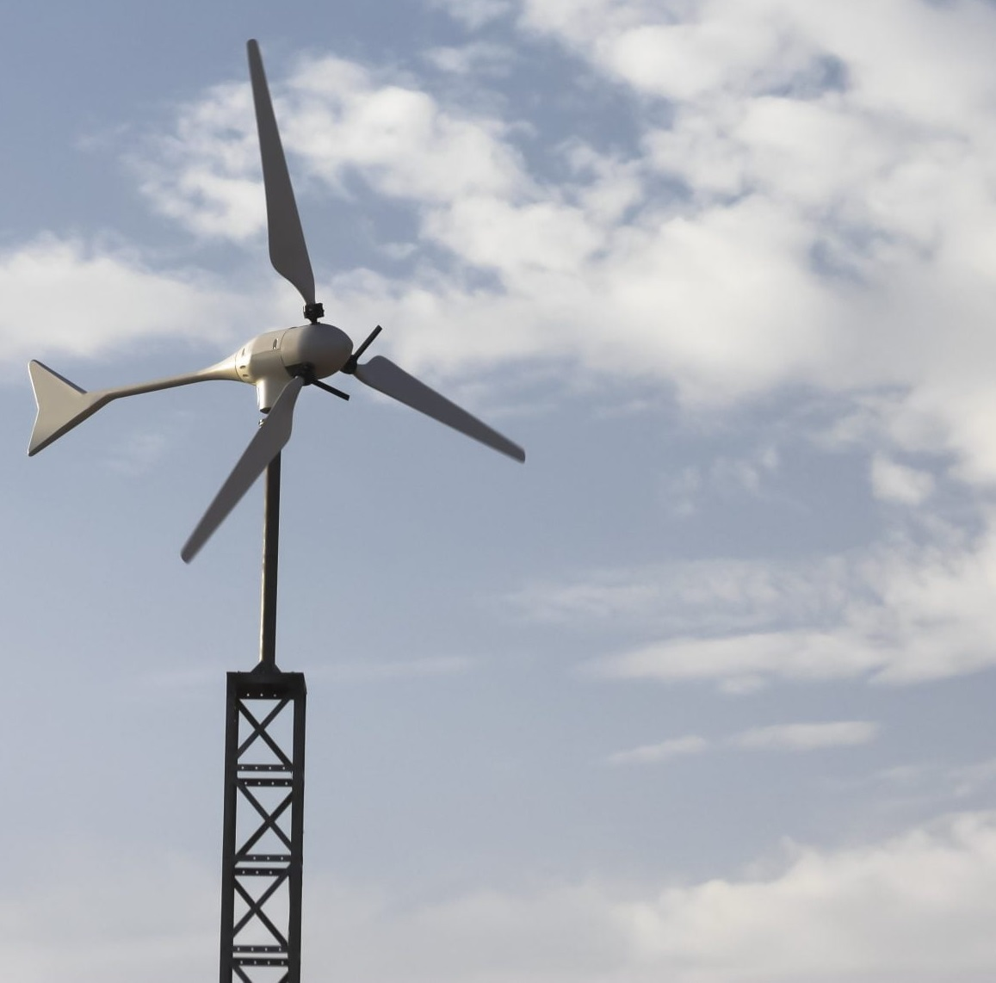

Team 7:
Wind-Powered Building
Team Members:
Colton, Reginald, Maxwell, Peter
Sponsor: Dr. Jang TA: Rohith Ramanujam Kumar
Notes:
https://www.ryse.energy/3kw-wind-turbines/#iLightbox[gallery_image_1]/11

Slide 2
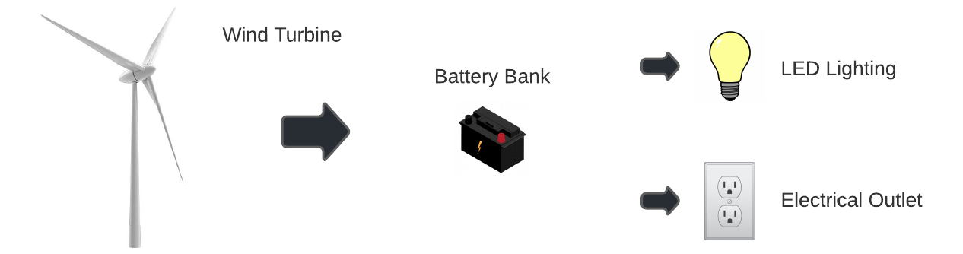
Project Summary
Implementing local renewable power generation to reduce reliance on fossil fuels
Using a wind turbine to capture energy, store it in batteries, and power AC and DC loads

Slide 3
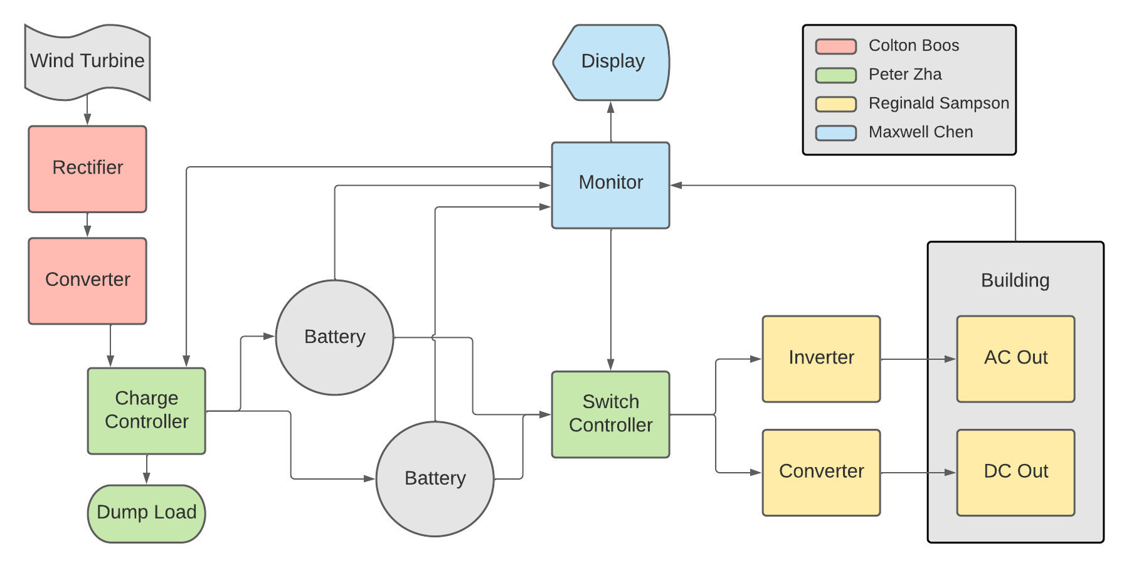
Block Diagram and Task Partition

Slide 4
Project Timeline
Early September 2022
Late September 2022
October 2022
November 2022
Refine Subsystems
Begin Integration
Continue Integration and Validation
Complete Validation
Ensure subsystems are in a working state and simulations are done.
Resolve any subsystem issues left over from the previous semester
All subsystems should be in complete working order.
Some PCBs and components/parts ordered and ready for soldering.
Continue and complete validation by no later than mid-October.
Final details and errors cleaned up. System should be completely validated and ready to present at showcase.

Slide 5
Rectification and Conversion Subsystem
Owner: Colton Boos
Accomplishments since 403 20 hours of effort | Ongoing progress/problems and plans until the next presentation
Finished simulations of buck-boost converter, utilizing a different IC from 403 Finished schematic and PCB design for rectifier | Finalize PCB design for buck-boost converter Start assembling components onto the rectifier PCB

Slide 6
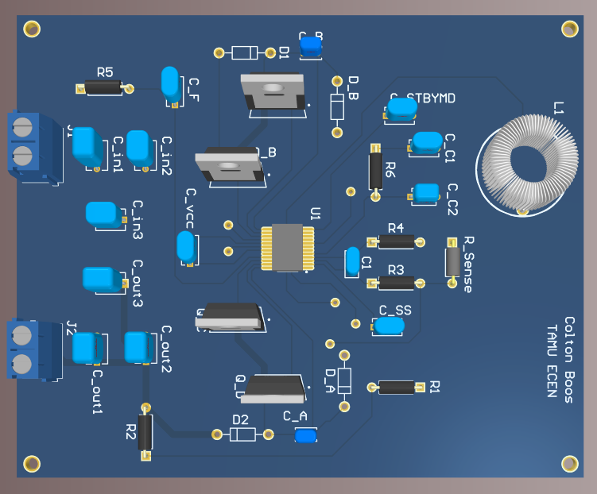
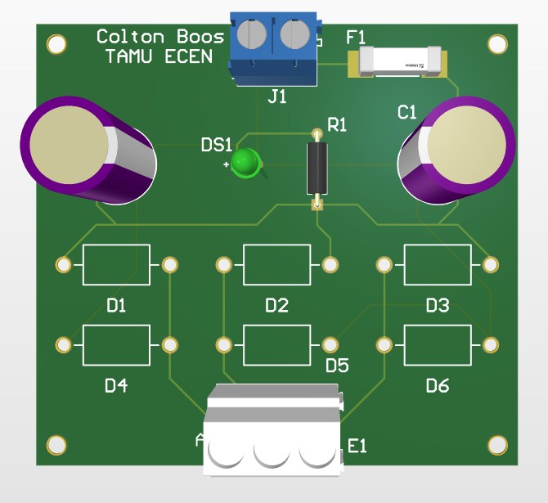
Rectification and Conversion Subsystem
Owner: Colton Boos
Rectifier
Same design from 403
Using different components with higher voltage/current ratings for robustness
Buck-Boost Converter
Output current depends on load resistance
Need to add load resistor at the output

Slide 7
Charge and Switch Controller Subsystem
Owner: Peter Zha
Accomplishments since 403 15 hours of effort | Ongoing progress/problems and plans until the next presentation
Finished new design and simulations Finished determining possible battery switching cases | Need to do some physical validations Design and order PCBs

Slide 8
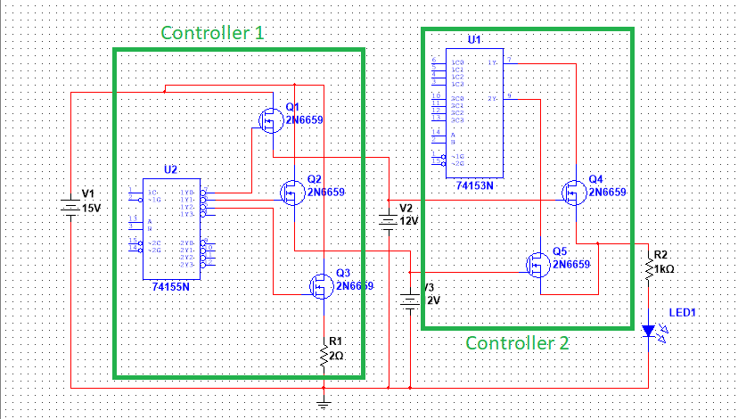
Charge and Switch Controller Subsystem
Owner: Peter Zha

Slide 9
Inversion and Conversion Subsystem
Owner: Reginald Sampson
Accomplishments since 403 20 hours of effort | Ongoing progress/problems and plans until the next presentation
Finished rebuilding the Inverter and Converter with updated parts Finished schematic of Inverter and Converter designs | Finalize PCB design for Converter and Inverter No spice model exists for the LM2577 and CD4047 to simulate

Slide 10
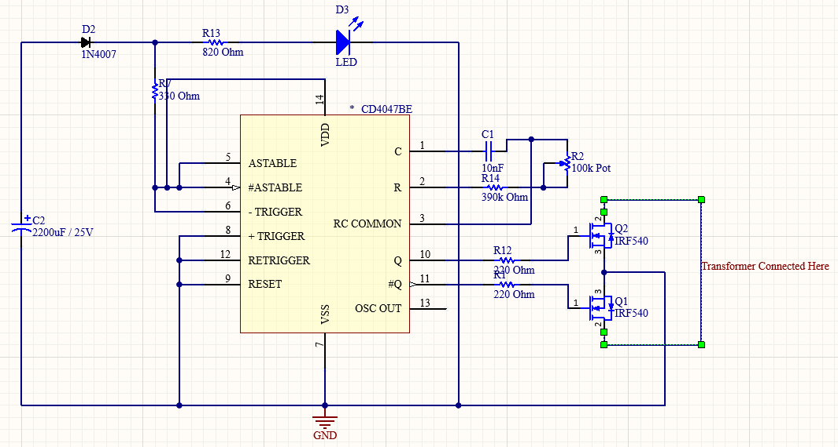
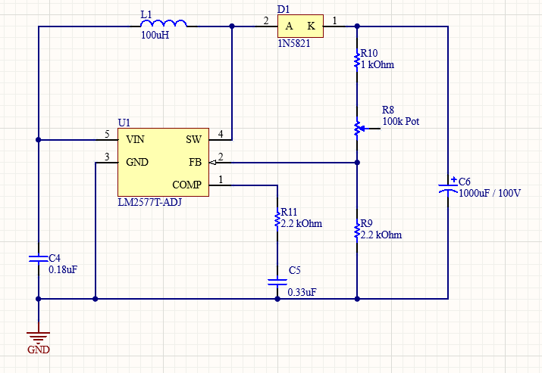
Inversion and Conversion Subsystem
Owner: Reginald Sampson

Slide 11
Monitor Subsystem
Owner: Maxwell Chen
Accomplishments since 403 10 hours of effort | Ongoing progress/problems and plans until the next presentation
Research on factors of Battery Health and Life Research on separate voltage and current sensors to use on the microcontroller | Integration of voltage and current sensors Implementation of Battery Health calculations onto the website through data gathered from the new sensors

Slide 12

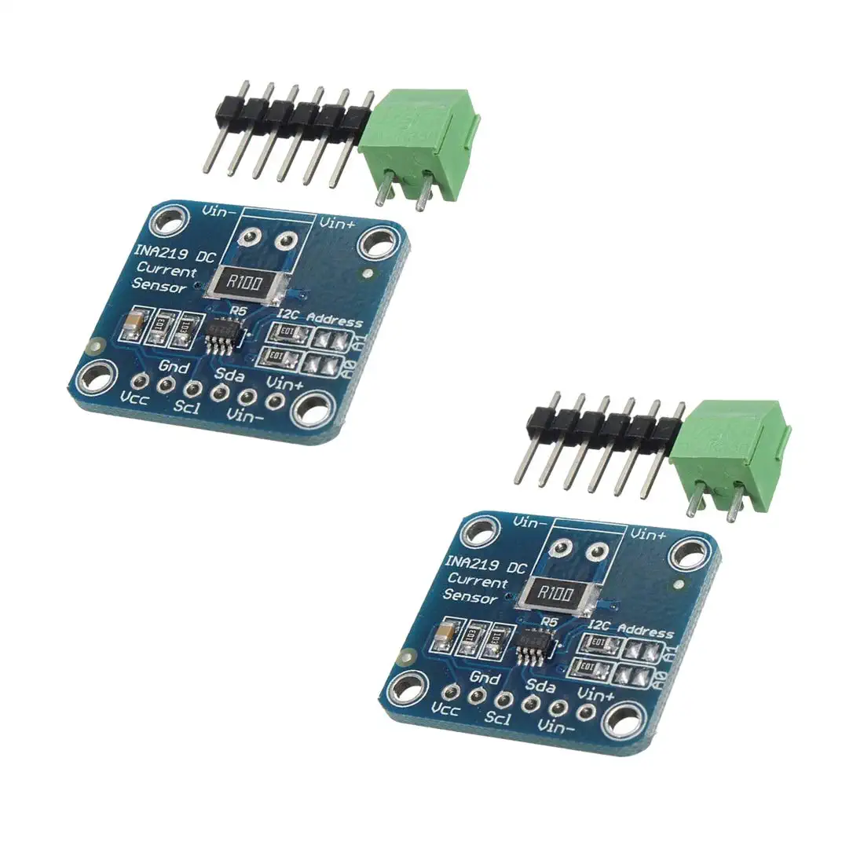
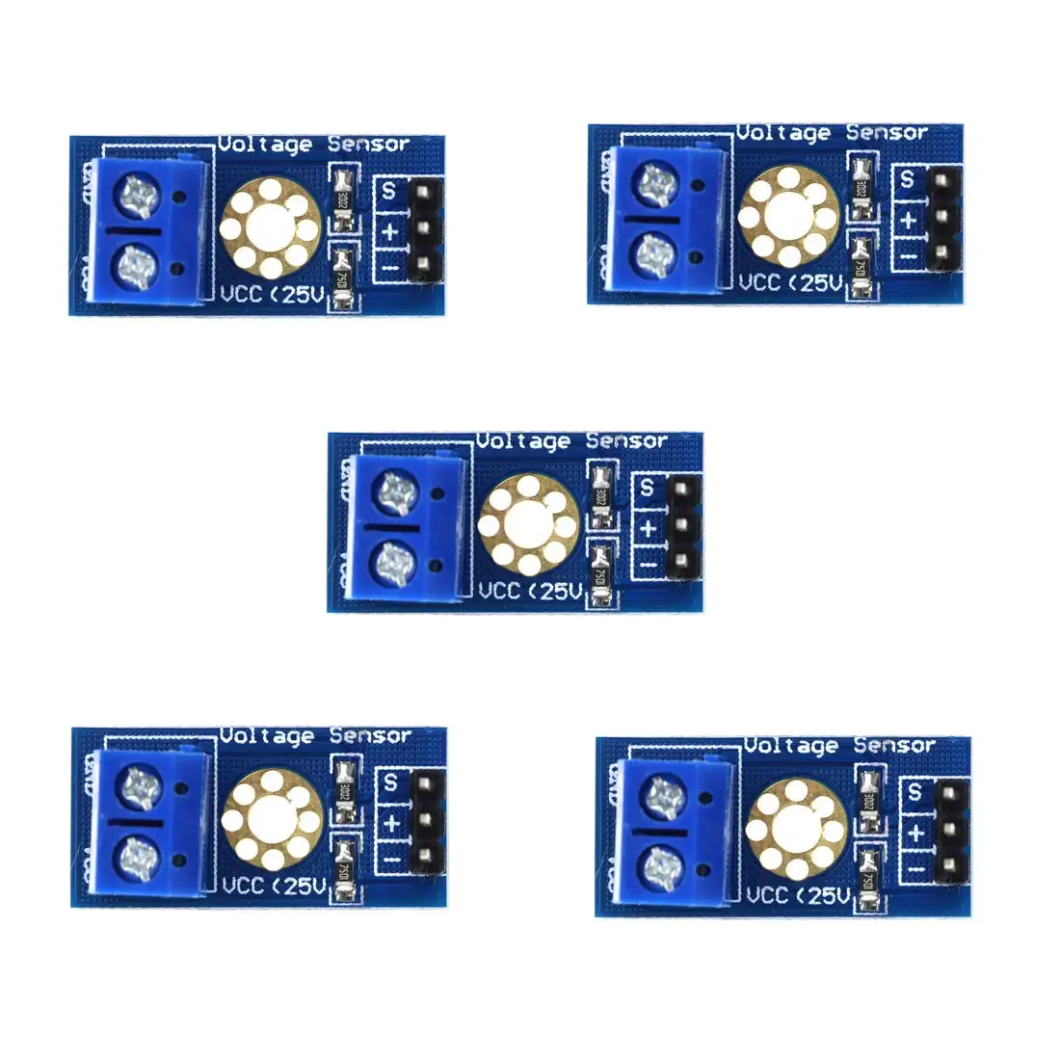
Monitor Subsystem
Owner: Maxwell Chen
State of Health can be used to determine our batteries health.
It can be described as the ratio of maximum battery charge to its rated capacity
Will be utilizing a current sensor and decided to use a voltage sensor for better accuracy and safety

Slide 13
Parts Ordering Status
Part Description | Status(Order Approved/ Order Placed/ Part Received
HiLetGo Voltage Sensor | Pending Approval
INA219 Current Sensor | Pending Approval
Power MOSFETs | Pending Approval
Rectifier PCB | Order Placed

Slide 14
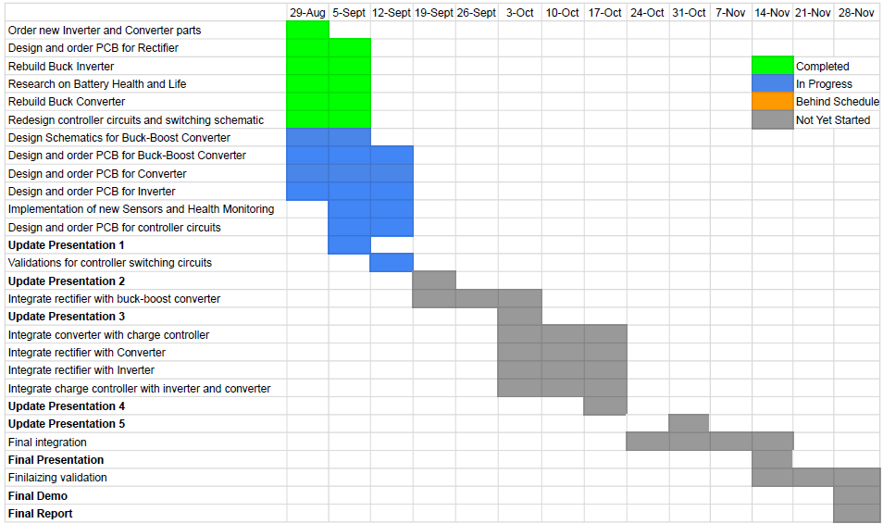
Execution & Plan

Slide 15
Thank you for listening
Any Questions?
Notes:
https://www.ryse.energy/3kw-wind-turbines/#iLightbox[gallery_image_1]/11

